Slide 1
DEBEREMARKOS UIVERSITY
Institute of technology, Software Engineering Academic program
Ge’ez handwritten characters recognition, detection and localization system project proposal

Slide 2
Prepared by:
Eba Alemayehu (TER_0075_09)
Nardos Sharifo (TER_0083_09)
Kerebesh Genet (TER_0088_09)

Slide 3
Outline
Part one
Introduction
What is the problem we are trying to solve
What others have done
How are we trying to solve this problem
Our solution
What are we trying to achieve in this project
What is the significance of this project

Slide 4
Cont…
Part two
What are the tools we are going to use
How do we collect our data
Systems we need in our project
Hardware we want to on our project
Is it feasible
Our budget plan
Work breakdown

Slide 5
Part one About the project

Slide 6
Introduction
Ge’ez is one of the principal languages of Ethiopia
Ge’ez has its own writing style and alphabet.
Ge'ez is the ancestor of the modern Amharic, Tigrinya and Tigré languages of Eritrea and Ethiopia.
The oldest known inscription in the language dates from the 3rd or 4th century and is written in a script that does not indicate vowels.

Slide 7
Cont…
Most of Ethiopian medieval history were written in Ge’ez characters.
Even in modern Ethiopia automation didn’t take over every government documents. We are still using hand writing in gov’t.
For instance we can see brana books, police records and even our id card

Slide 8
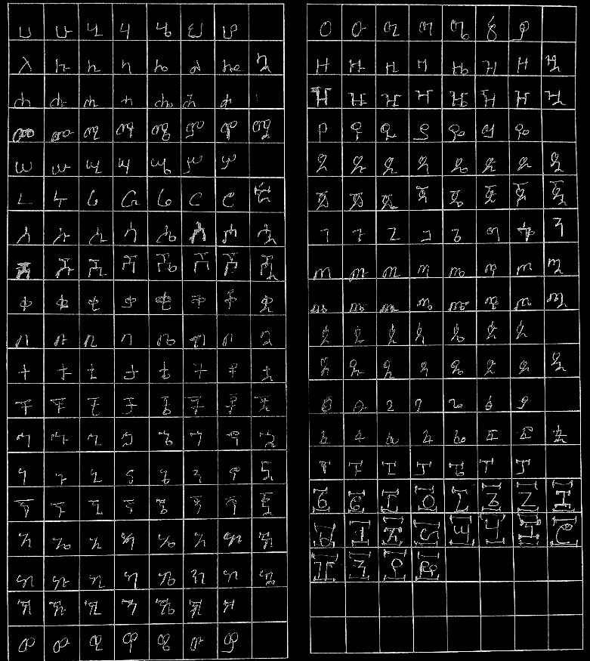

Slide 9



What is the problem we are trying to solve
Humans can easily recognize characters once they have learned them in spite of how distorted they are.

Slide 10
Cont...
For machine it is very difficult to understand this unpredictable handwritten characters.
But know a days deep learning algorithms and a growing power of computer power especially GPU hardware, computers are Being able to recognize this kind of complex patter with a cloth to human accuracy level.
Also the emergence of big data is contributing a lot in this area.

Slide 11
Why do we need to recognize
Because know a days we are inputting any handwritten characters by typing which takes a lot of time and labor.
Automated systems may need to read strings written in Amharic characters
The world is being taken over by AGI system. One of the biggest issues is the diversity. The data we feed for our AI systems must be diverse other wise different bias will be embedded in the systems
This will put at us on difficult position in a difficult position in a digital divide.

Slide 12
What others have done
There are limited research works for Ethiopic character recognition.
​(Assabie u. Bigun, 2011; Meshesha u. Jawahar, 2007)​ hare tied to produce Amharic dataset in there respective research works.
The first attempt for Amharic online character recognition was reported by ​Cowell u. Hussain (2003)​.
​Assabie u. Bigun (2008) ​have im- plemented online handwritten character recognition for Ethiopic script based on the characteristics of primitive strokes that make up characters.

Slide 13
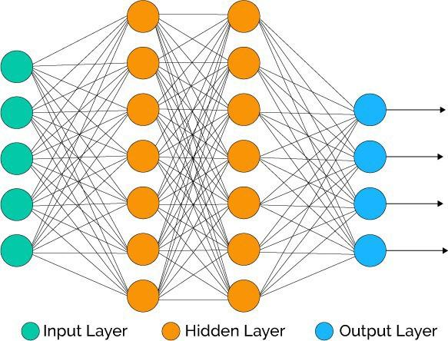
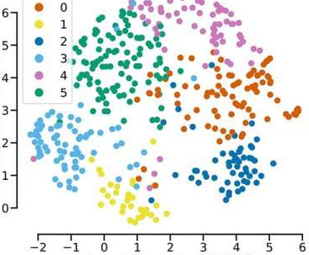
How are we trying to solve this problem
We are trying to solve this problem using deep learning.

Slide 14
Cont...
The architecture we are going to use will be called Convolutional Neural Networks (CNN).
This days this architecture is out performing any other architectures on a computer vision task.
In our project will be preparing a dataset, we are going to train a model with this dataset and build different applications which make use of this system.
A trained machine learning model with decent accuracy will solve the core problem.

Slide 15
What are we trying to achieve in this project
To build a computer system that can recognize any handwritten ge’ez characters.
Preparing ge’ez characters dataset which is publicly available and anyone who want to experiment on it can try out.
To find the best learning algorithm and neural network architecture
To train a model which can classify Amharic characters
To make application software which make use of the trained model

Slide 16
What our project include
Ge’ez character dataset collection
Designing the learning algorithm and architecture
Training the model with the collected dataset and Designed architecture
Building an application on the top of the trained model
Different small programs that help to automate some tasks on the process for instance data collection.

Slide 17
Our project doesn’t include
Any natural language processing. Our system does not understand the meaning of a text.
No semantic analysis or data mining on text is done.
Word or sentence based recognition. Our system is character based recognition.

Slide 18
What is the significance of this project
On one side the system we are going to build an application which can solve some problems.
It includes API that developers we amazing idea can build applications.
On the other side when we see the big picture it could be one step forward for next AI projects that can be done with our juniors.

Slide 19
Part two

Slide 20


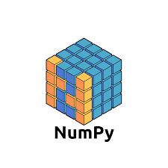



What are the tools we are going to use
Programming languages
Python
Javascript
Java, swift or dart (optional)
Html and css
Tools and technologies
Opencv
Tensor flow
Flutter
Keras
Numpy
Matplotlib
django or flask

Slide 21
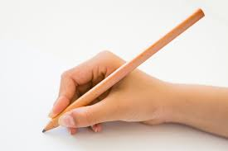
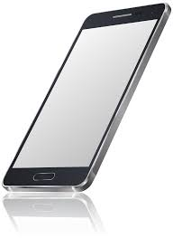
How do we collect our data
By distributing questionnaire paper to different people to get there handwriting.
Building an android app which help us collect characters data. The app will have a canvas to enable draw characters on screen.

Slide 22




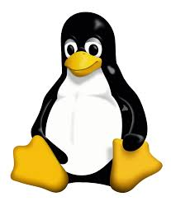

Systems we need in our project
Software system
Androids studio
Visual studio code
Apache server
Google chrome for debugging
Operating system
Linux
Windows
Mac os

Slide 23
Hardware we want to on our project
Two computers one for training the model one for a development. The specification for these two computers are listed as follows.
Training server: core i7 processor, 16GB RAM 1 TB storage with GPU capability.
Development pc: core i7 processor, 8GB RAM 1 TB storage.
Android and iPhone devices for testing
Printed paper for data collection
Other office apparatus for different purposes

Slide 24
Is it feasible
Technically
Operational
Economic

Slide 25
Our budget plan
Item | Measurement | Quantity | Unit price | Total
Computers | each | 2 | 25,000 birr | 50,000 birr
Copying paper | each | 350 | 1 birr | 350 birr
Sticky notes | each | 2 | 25 birr | 50 birr
All software and technologies | Uncountable | Uncountable | Free | free

Slide 26
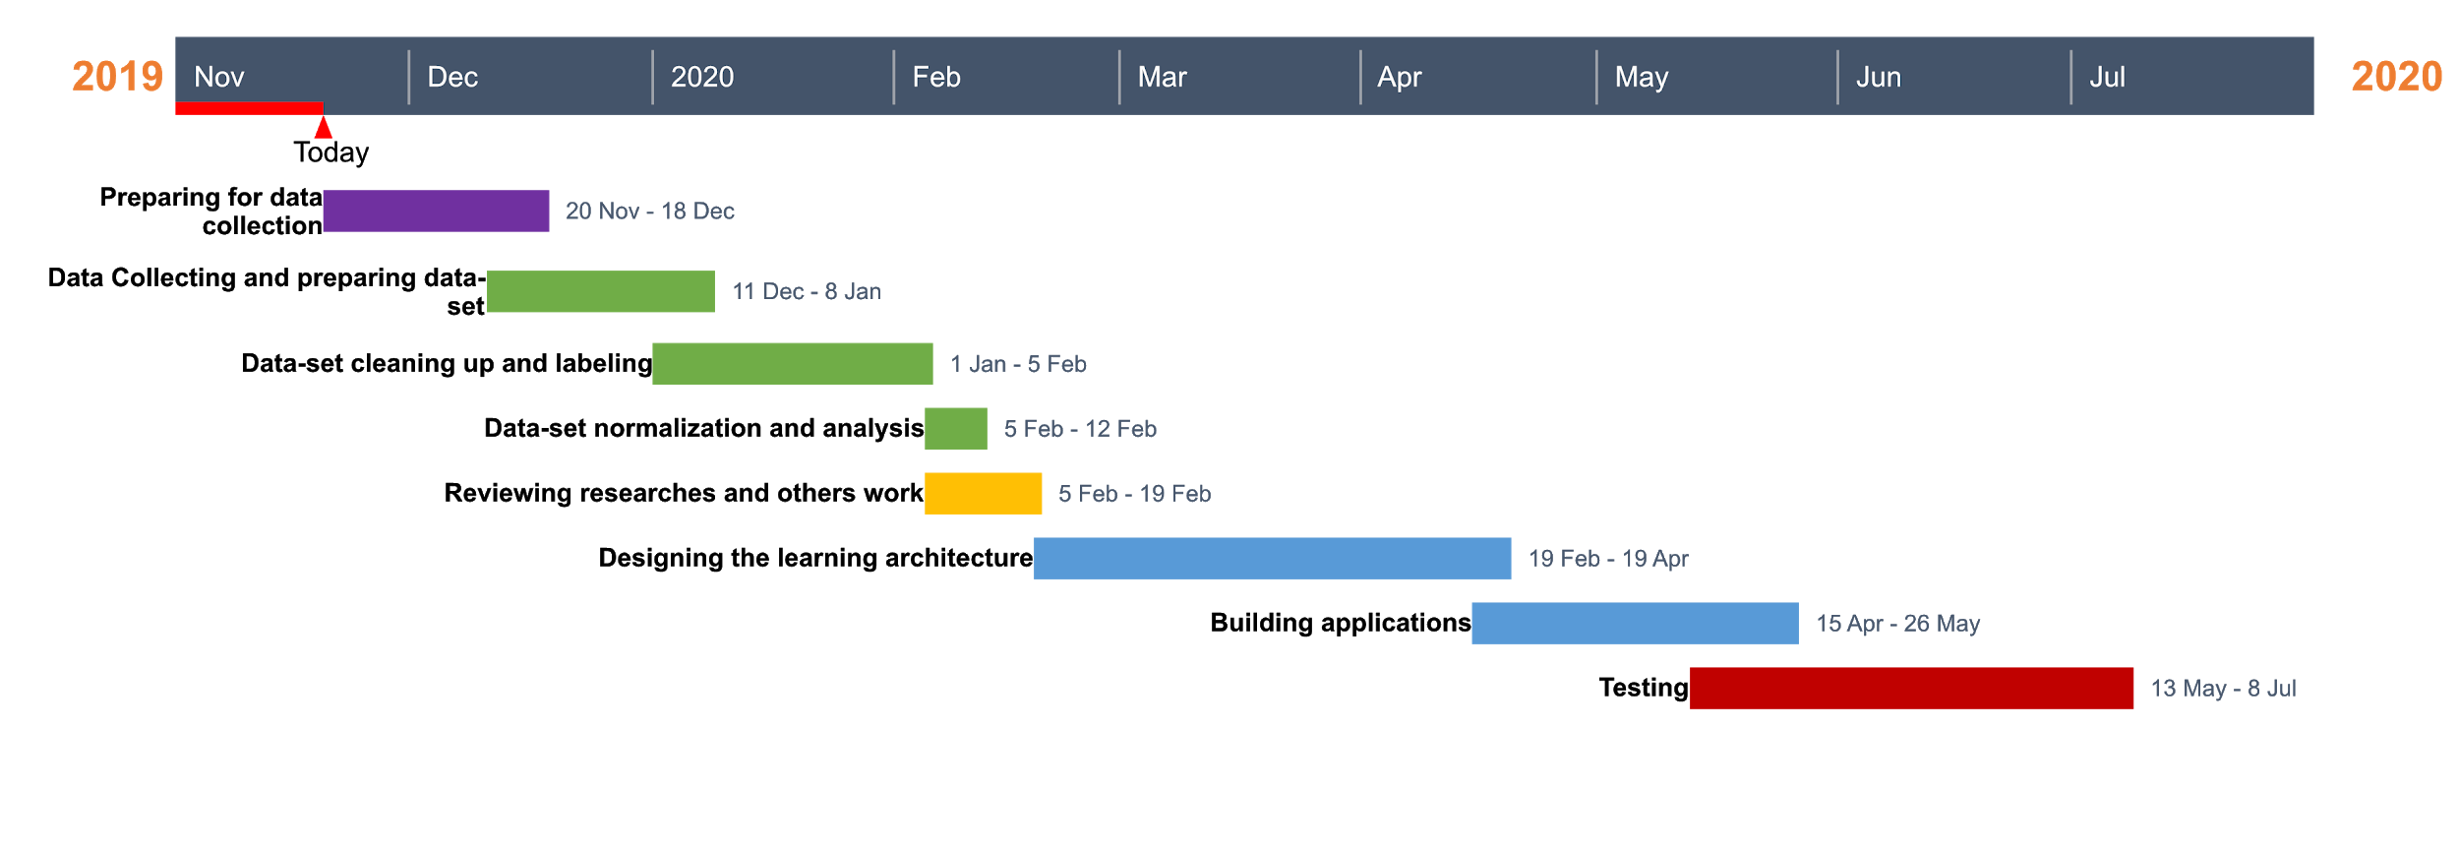
Work breakdown

Slide 27
Challenges
We need a lot of data for training the model
Amharic is a phonetic language so it has a lot of characters which are very similar
We have a very limited computational power which make training the model so slow.

Slide 28

we are open to accept your constructive comment and suggestions

